Slide 1

Logical Agents - Knowledge Based System
Chapter 5
Notes:
1

Slide 2
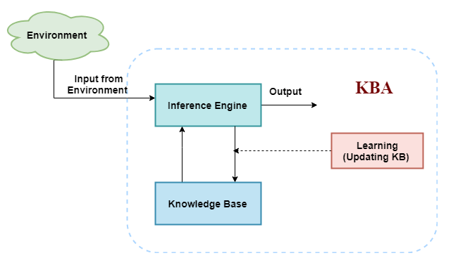
Introduction
KBA have the capability of maintaining an internal state of knowledge, reason over that knowledge, update their knowledge after observations and take actions.
These agents can represent the world with some formal representation and act intelligently.
Knowledge base:
Knowledge-base is a central component of a knowledge-based agent, it is also known as KB. It is a collection of sentences
The Knowledge-base of KBA stores fact about the world.
Inference system
Inference means deriving new sentences from old. Inference system allows us to add a new sentence to the knowledge base.
A sentence is a proposition about the world. Inference system applies logical rules to the KB to deduce new information.

Slide 3
A KBA must able to do
An agent should be able to represent states, actions, etc.
An agent Should be able to incorporate new percepts
An agent can update the internal representation of the world
An agent can deduce the internal representation of the world
An agent can deduce appropriate actions.
Various levels of knowledge-based agent:
1. Knowledge level
we need to specify what the agent knows, and what the agent goals are.
E.g., an automated taxi agent needs to go from a station A to station B, and he knows the way from A to B, so this comes at the knowledge level.
2. Logical level:
At this level, we understand that how the knowledge representation of knowledge is stored. At the logical level we can expect to the automated taxi agent to reach to the destination B.
Operations Performed by KBA
Following are three operations which are performed by KBA in order to show the intelligent behavior:
TELL: This operation tells the knowledge base what it perceives from the environment.
ASK: This operation asks the knowledge base what action it should perform.
Perform: It performs the selected action.
3. Implementation level:
This is the physical representation of logic and knowledge. agent perform actions as per logical and knowledge level. an automated taxi agent actually implement his knowledge and logic so that he can reach to the destination.

Slide 4
Knowledge Representation / (KR, KRR)
KR, KRR is the part of Artificial intelligence which concerned with AI agents thinking and how thinking contributes to intelligent behavior of agents.
What to Represent:
Following are the kind of knowledge which needs to be represented in AI systems:
  Object: All the facts about objects in our world domain. E.g., Guitars contains strings, trumpets are brass instruments.
  Events: Events are the actions which occur in our world.
  Performance: It describe behavior which involves knowledge about how to do things.
  Meta-knowledge: It is knowledge about what we know.
  Facts: Facts are the truths about the real world and what we represent.
  Knowledge-Base: The central component of the knowledge-based agents is the knowledge base. It is represented as KB.

Slide 5
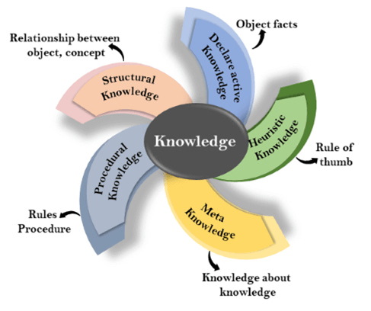
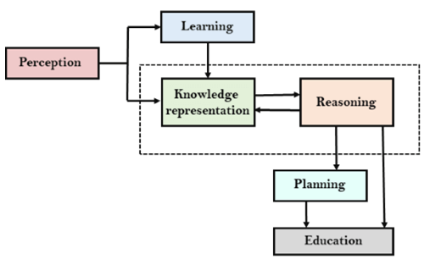
AI Knowledge cycle
Perception
Learning
Knowledge Representation and Reasoning
Planning
Execution

Slide 6
Types of knowledge
1. Declarative Knowledge:
Declarative knowledge is to know about something.
It includes concepts, facts, and objects.
It is also called descriptive knowledge and expressed in declarative sentences.
It is simpler than procedural language.
4. Heuristic knowledge:
Heuristic knowledge is representing knowledge of some experts in a filed or subject.
Heuristic knowledge is rules of thumb based on previous experiences, awareness of approaches, and which are good to work but not guaranteed.
5. Structural knowledge:
Structural knowledge is basic knowledge to problem-solving.
It describes relationships between various concepts such as kind of, part of, and grouping of something.
It describes the relationship that exists between concepts or objects.
2. Procedural Knowledge
It is also known as imperative knowledge.
Procedural knowledge is a type of knowledge which is responsible for knowing how to do something.
It can be directly applied to any task.
It includes rules, strategies, procedures, agendas, etc.
Procedural knowledge depends on the task on which it can be applied.
3. Meta-knowledge:
Knowledge about the other types of knowledge is called Meta-knowledge.
Reading Ass: The relation between knowledge and intelligence

Slide 7
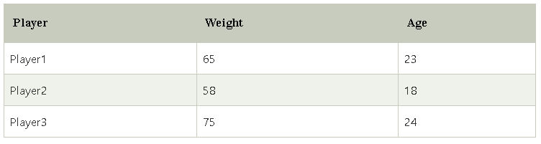
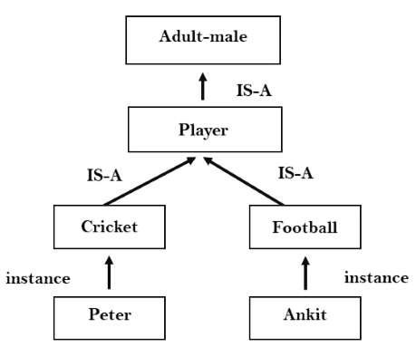
Approaches to Knowledge Representation:
1. Simple relational knowledge:
It is the simplest way of storing facts which uses the relational method, and each fact about a set of the object is set out systematically in columns.
2. Inheritable knowledge:
3. Inferential knowledge:
Example: Let's suppose there are two statements:
  Marcus is a man
  All men are mortal
  Then it can represent as;
  man(Marcus)
  ∀x = man (x) ----------> mortal (x)s
4. Procedural knowledge:
Procedural knowledge approach uses small programs and codes which describes how to do specific things, and how to proceed.
If-Then rule approach
coding languages such as LISP language and Prolog language.

Slide 8
Requirements for knowledge Representation system:
Representational Accuracy:
KR system should have the ability to represent all kind of required knowledge.
2. Inferential Adequacy:
KR system should have ability to manipulate the representational structures to produce new knowledge corresponding to existing structure.
3. Inferential Efficiency:
The ability to direct the inferential knowledge mechanism into the most productive directions by storing appropriate guides.
4. Acquisitional efficiency-
The ability to acquire the new knowledge easily using automatic methods.

Slide 9
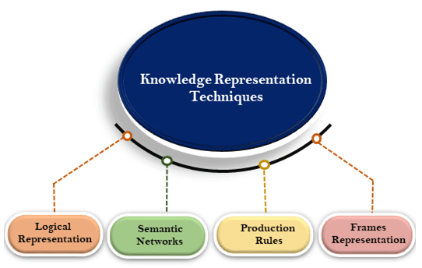
Techniques of Knowledge representation
1. Logical Representation
Logical representation is a language with some concrete rules which deals with propositions and has no ambiguity in representation. Means drawing a conclusion based on various conditions.
Consists of precisely defined syntax and semantics which supports the sound inference. 2 categories include:
  Propositional Logics
  Predicate logics
Advantages of logical representation:
Logical representation enables us to do logical reasoning.
Logical representation is the basis for the programming languages.
Disadvantages of logical Representation:
Logical representations have some restrictions and are challenging to work with.
Logical representation technique may not be very natural, and inference may not be so efficient.

Slide 10
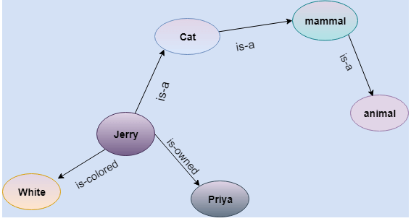
2. Semantic Network Representation
Are alternative of predicate logic for knowledge representation.
we can represent our knowledge in the form of graphical networks.
can categorize the object in different forms and can also link those objects.
Are easy to understand and can be easily extended.
This representation consist of mainly two types of relations:
  IS-A relation (Inheritance)
  Kind-of-relation
Jerry is a cat.
Jerry is a mammal
Jerry is owned by Priya.
Jerry is brown colored.
All Mammals are animal.
Advantages of Semantic network:
Semantic networks are a natural representation of knowledge.
Semantic networks convey meaning in a transparent manner.
These networks are simple and easily understandable.
Drawbacks in Semantic representation: reading ass

Slide 11
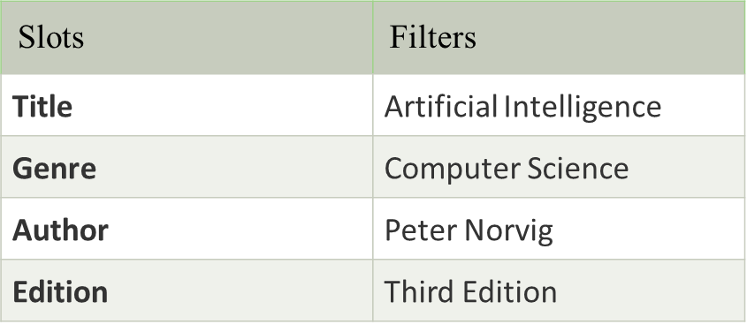
3. Frame Representation
A frame is a record like structure which consists of a collection of attributes and its values to describe an entity in the world. Frames are the AI data structure which divides knowledge into substructures by representing stereotypes situations.
consists of a collection of slots and slot values. These slots may be of any type and sizes. Slots have names and values which are called facets.
A frame is also known as slot-filter knowledge representation in artificial intelligence.
Advantages of frame representation:
The frame knowledge representation makes the programming easier by grouping the related data.
The frame representation is comparably flexible and used by many applications in AI.
It is very easy to add slots for new attribute and relations.
It is easy to include default data and to search for missing values.
Frame representation is easy to understand and visualize.
Disadvantages of frame representation:
In frame system inference mechanism is not be easily processed.
Inference mechanism cannot be smoothly proceeded by frame representation.
Frame representation has a much generalized approach.

Slide 12
4. Production Rules
Production rules system consist of (condition, action) pairs which mean, "If condition then action". It has mainly three parts:
  The set of production rules
  Working Memory
  The recognize-act-cycle
The condition part of the rule determines which rule may be applied to a problem. And the action part carries out the associated problem-solving steps. This complete process is called a recognize-act cycle.
Advantages of Production rule:
Are expressed in natural language.
Are highly modular, so we can easily remove, add or modify an individual rule.
Disadvantages of Production rule:
does not exhibit any learning capabilities, as it does not store the result of the problem for the future uses.
During the execution of the program, many rules may be active hence rule-based production systems are inefficient.
Example:
IF (at bus stop AND bus arrives) THEN action (get into the bus)
IF (on the bus AND paid AND empty seat) THEN action (sit down).
IF (on bus AND unpaid) THEN action (pay charges).
IF (bus arrives at destination) THEN action (get down from the bus).

Slide 13
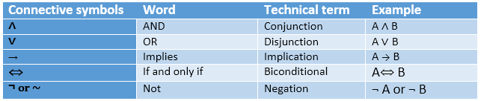
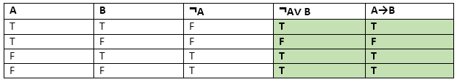
Propositional logic in Artificial intelligence
(PL) is the simplest form of logic where all the statements are made by propositions. A proposition is a declarative statement which is either true or false. It is a technique of knowledge representation in logical and mathematical form.
Propositions can be either true or false, but it cannot be both.
Propositional logic consists of an object, relations or function, and logical connectives/operators.
The propositions and connectives are the basic elements of the propositional logic.
Connectives can be said as a logical operator which connects two sentences.
A proposition formula which is always true is called tautology, and it is also called a valid sentence.
A proposition formula which is always false is called Contradiction.
Syntax of propositional logic:
The syntax of propositional logic defines the allowable sentences for the knowledge representation. There are two types of Propositions:
  Atomic Propositions: simple propositions
  Compound propositions: combining atomic propositions
Logical equivalence:
Logical equivalence is one of the features of propositional logic. Two propositions are said to be logically equivalent if and only if the columns in the truth table are identical to each other.

Slide 14
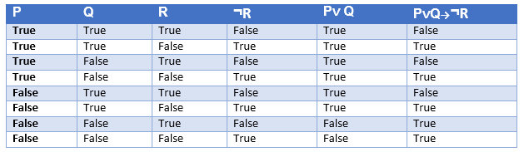
Truth table with three propositions:
We can build a proposition composing three propositions P, Q, and R. This truth table is made-up of 8n Tuples as we have taken three proposition symbols.
Precedence of connectives:
Precedence | Operators
First Precedence | Parenthesis
Second Precedence | Negation
Third Precedence | Conjunction(AND)
Fourth Precedence | Disjunction(OR)
Fifth Precedence | Implication
Six Precedence | Biconditional
Just like arithmetic operators, there is a precedence order for propositional connectors or logical operators.
This order should be followed while evaluating a propositional problem. Following is the list of the precedence order for operators:

Slide 15
Properties of Operators:
Commutativity:
  P∧ Q= Q ∧ P, or
  P ∨ Q = Q ∨ P.
Associativity:
  (P ∧ Q) ∧ R= P ∧ (Q ∧ R),
  (P ∨ Q) ∨ R= P ∨ (Q ∨ R)
Identity element:
  P ∧ True = P,
  P ∨ True= True.
Distributive:
  P∧ (Q ∨ R) = (P ∧ Q) ∨ (P ∧ R).
  P ∨ (Q ∧ R) = (P ∨ Q) ∧ (P ∨ R).
DE Morgan's Law:
  ¬ (P ∧ Q) = (¬P) ∨ (¬Q)
  ¬ (P ∨ Q) = (¬ P) ∧ (¬Q).
Double-negation elimination:
  ¬ (¬P) = P.
Limitations of Propositional logic:
We cannot represent relations like ALL, some, or none with propositional logic. Example:
  All the girls are intelligent.
  Some apples are sweet.
Propositional logic has limited expressive power.
In propositional logic, we cannot describe statements in terms of their properties or logical relationships.

Slide 16





Rules of Inference in Artificial intelligence
we need intelligent computers which can create new logic from old logic or by evidence, so generating the conclusions from evidence and facts is termed as Inference.
Inference rules:
Inference rules are the templates for generating valid arguments. Inference rules are applied to derive proofs in artificial intelligence, and the proof is a sequence of the conclusion that leads to the desired goal.
Implication: It is one of the logical connectives which can be represented as P → Q. It is a Boolean expression.
Converse: The converse of implication, which means the right-hand side proposition goes to the left-hand side and vice-versa. It can be written as Q → P.
Contrapositive: The negation of converse is termed as contrapositive, and it can be represented as ¬ Q → ¬ P.
Inverse: The negation of implication is called inverse. It can be represented as ¬ P → ¬ Q.
3. Disjunction Syllogism:
4. Simplification:
5. Resolution:
Types of Inference rules:
1. Modus Ponens:
2. Modus Tollens:

Slide 17
First-Order Logic in Artificial intelligence

Slide 18
First-Order Logic in Artificial intelligence
In propositional logic, we can only represent the facts, which are either true or false. PL is not sufficient to represent the complex sentences or natural language statements.
E.G.: "Some humans are intelligent“, To represent the above statements, PL logic is not sufficient, so we required some more powerful logic, such as first-order logic.
First-Order logic:
First-order logic is another way of knowledge representation in artificial intelligence. It is an extension to propositional logic.
FOL is sufficiently expressive to represent the natural language statements in a concise way.
First-order logic is also known as Predicate logic or First-order predicate logic.
First-order logic is a powerful language that develops information about the objects in a more easy way and can also express the relationship between those objects.
Elements of FOL
Constant | 1, 2, A, John, Mumbai, cat,....
Variables | x, y, z, a, b,....
Predicates | Brother, Father, >,....
Function | sqrt, LeftLegOf, ....
Connectives | ∧, ∨, ¬, ⇒, ⇔
Equality | ==
Quantifier | ∀, ∃

Slide 19
First-order logic (like natural language) does not only assume that the world contains facts like propositional logic but also assumes the following things in the world:
  Objects: A, B, people, numbers, colors, wars, theories, squares, pits, wumpus, ......
  Relations: It can be unary relation such as: red, round, is adjacent, or n-any relation such as: the sister of, brother of, has color, comes between
  Function: Father of, best friend, third inning of, end of, ......
As a natural language, first-order logic also has two main parts:
  Syntax
  Semantics
Constant | 1, 2, A, John, Mumbai, cat,....
Variables | x, y, z, a, b,....
Predicates | Brother, Father, >,....
Function | sqrt, LeftLegOf, ....
Connectives | ∧, ∨, ¬, ⇒, ⇔
Equality | ==
Quantifier | ∀, ∃
Syntax of First-Order logic:
The syntax of FOL determines which collection of symbols is a logical expression in first-order logic. The basic syntactic elements of first-order logic are symbols. We write statements in short-hand notation in FOL.
Basic Elements of First-order logic:
Following are the basic elements of FOL syntax:

Slide 20
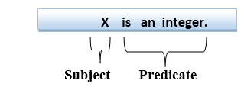
Atomic sentences:
Atomic sentences are the most basic sentences of first-order logic. These sentences are formed from a predicate symbol followed by a parenthesis with a sequence of terms.
We can represent atomic sentences as Predicate (term1, term2, ......, term n).
Example: Ravi and Ajay are brothers: => Brothers(Ravi, Ajay).
Chinky is a cat: => cat (Chinky).
Complex Sentences:
Complex sentences are made by combining atomic sentences using connectives.
First-order logic statements can be divided into two parts:
Subject: Subject is the main part of the statement.
Predicate: A predicate can be defined as a relation, which binds two atoms together in a statement.
Consider the statement: "x is an integer.", it consists of two parts, the first part x is the subject of the statement and second part "is an integer," is known as a predicate.

Slide 21
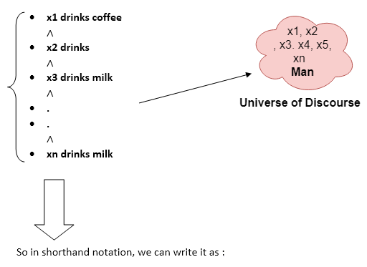
Quantifiers in First-order logic:
A quantifier is a language element which generates quantification, and quantification specifies the quantity of specimen in the universe of discourse.
These are the symbols that permit to determine or identify the range and scope of the variable in the logical expression. There are two types of quantifier:
Universal Quantifier:
Universal quantifier is a symbol of logical representation, which specifies that the statement within its range is true for everything or every instance of a particular thing.
is represented by a symbol ∀. In universal quantifier we use implication "→".
If x is a variable, then ∀x is read as: For all x, For each x, For every x.
Example: All man drink coffee.
It will be read as: There are all x where x is a man who drink coffee.

Slide 22
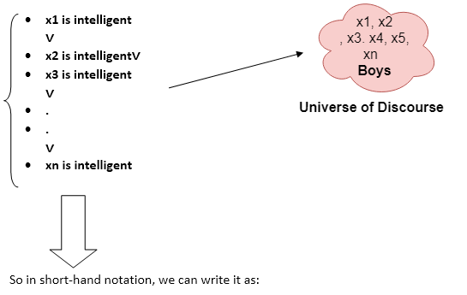
Existential Quantifier:
Existential quantifiers are the type of quantifiers, which express that the statement within its scope is true for at least one instance of something. D
Denoted by the logical operator ∃.
When it is used with a predicate variable then it is called as an existential quantifier.
Note: In Existential quantifier we always use AND or Conjunction symbol (∧).
If x is a variable, then existential quantifier will be ∃x or ∃(x). And it will be read as: There exists a 'x.’, For some 'x.’ , For at least one 'x.’
Example:
∃x: boys(x) ∧ intelligent(x)
It will be read as: There are some x where x is a boy who is intelligent.

Slide 23
Free and Bound Variables:
The quantifiers interact with variables which appear in a suitable way.
There are two types of variables in First-order logic which are given below:
Free Variable: A variable is said to be a free variable in a formula if it occurs outside the scope of the quantifier.
  Example: ∀x ∃(y)[P (x, y, z)], where z is a free variable.
B. Bound Variable: A variable is said to be a bound variable in a formula if it occurs within the scope of the quantifier.
Example: ∀x [A (x) B( y)], here x and y are the bound variables.
Reading assignment: knowledge engineering in FOL, inference in FOL, Resolution in FOL, and unification in FOL

Slide 24
Forward and back-ward chaining
Forward chaining: start from the known facts and move forward by applying inference rules to extract more data, and it continues until it reaches to the goal, whereas
Backward chaining: starts from the goal, move backward by using inference rules to determine the facts that satisfy the goal.
Forward chaining is called a data-driven inference technique, backward chaining is called a goal-driven inference technique.
Forward chaining down-up approach, whereas backward chaining is top-down approach.
Forward chaining uses BFS strategy, whereas backward chaining uses DFS strategy.
Both applies Modus ponens inference rule.

Slide 25
Reasoning in AI
The reasoning is the mental process of deriving logical conclusion and making predictions from available knowledge, facts, and beliefs.
Or we can say, "Reasoning is a way to infer facts from existing data." It is a general process of thinking rationally, to find valid conclusions.
In artificial intelligence, the reasoning is essential so that the machine can also think rationally as a human brain, and can perform like a human.
Types of Reasoning
In artificial intelligence, reasoning can be divided into the following categories:
        Deductive reasoning [G1]
        Inductive reasoning [G2]
        Abductive reasoning [G3]
        Common Sense Reasoning [G4]
        Monotonic Reasoning [G5]
        Non-monotonic Reasoning [G6]

Slide 26
Difference between Inductive and Deductive reasoning
Deductive reasoning uses available facts, information, or knowledge to deduce a valid conclusion, whereas inductive reasoning involves making a generalization from specific facts, and observations.
Deductive reasoning uses a top-down approach, whereas inductive reasoning uses a bottom-up approach.
Deductive reasoning moves from generalized statement to a valid conclusion, whereas Inductive reasoning moves from specific observation to a generalization.
In deductive reasoning, the conclusions are certain, whereas, in Inductive reasoning, the conclusions are probabilistic.
Deductive arguments can be valid or invalid, which means if premises are true, the conclusion must be true, whereas inductive argument can be strong or weak, which means conclusion may be false even if premises are true.

Slide 27
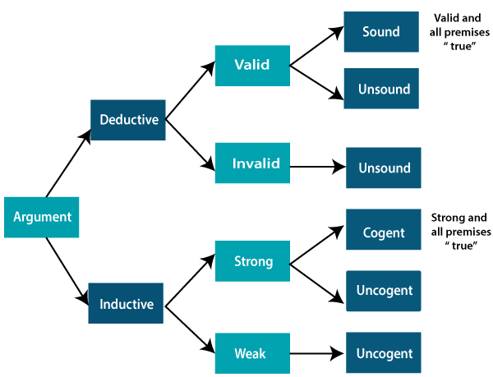

Slide 28
Basis for comparison | Deductive Reasoning | Inductive Reasoning
Definition | Deductive reasoning is the form of valid reasoning, to deduce new information or conclusion from known related facts and information. | Inductive reasoning arrives at a conclusion by the process of generalization using specific facts or data.
Approach | Deductive reasoning follows a top-down approach. | Inductive reasoning follows a bottom-up approach.
Starts from | Deductive reasoning starts from Premises. | Inductive reasoning starts from the Conclusion.
Validity | In deductive reasoning conclusion must be true if the premises are true. | In inductive reasoning, the truth of premises does not guarantee the truth of conclusions.
Usage | Use of deductive reasoning is difficult, as we need facts which must be true. | Use of inductive reasoning is fast and easy, as we need evidence instead of true facts. We often use it in our daily life.
Process | Theory→ hypothesis→ patterns→confirmation. | Observations-→patterns→hypothesis→Theory.
Argument | In deductive reasoning, arguments may be valid or invalid. | In inductive reasoning, arguments may be weak or strong.
Structure | Deductive reasoning reaches from general facts to specific facts. | Inductive reasoning reaches from specific facts to general facts.

